Slide 1
Biomass-To-Liquid technologies: status of recent developments & challenges
datum:
27/09/2021
jméno:
Jiří Hájek, CEO and chairman of BoD, ORLEN UniCRE

Slide 2
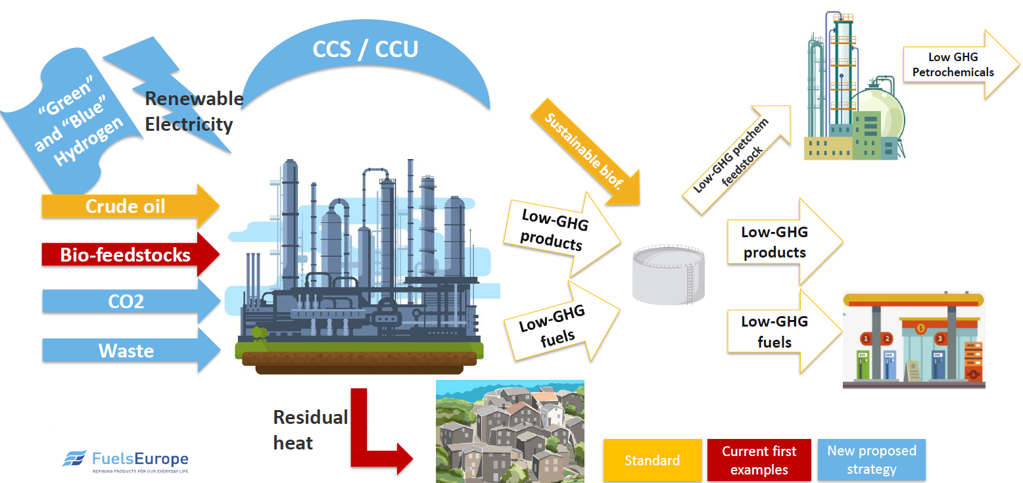
Fuels production vision 2050

Slide 3
Biofuels production
Ambition:
RED II (III) compliance;
Reduction of carbon footprint related to automotive, marine and aviation fuels utilization;
Focus:
Forest and agriculture residuum, municipal waste;
Key challenges:
Waste biogenic feedstock provision → effective collection, storage, analysis, pretreatment;
Technology maturity → TRL level, feedstock flexibility, feed quality sensitivity, yield of desired products, energy and hydrogen consumption, undesired product/waste utilization;
Co-processing vs stand alone installation;
Blending potential with existing fuels → RON, CI, stability, oxygen content;

Slide 4
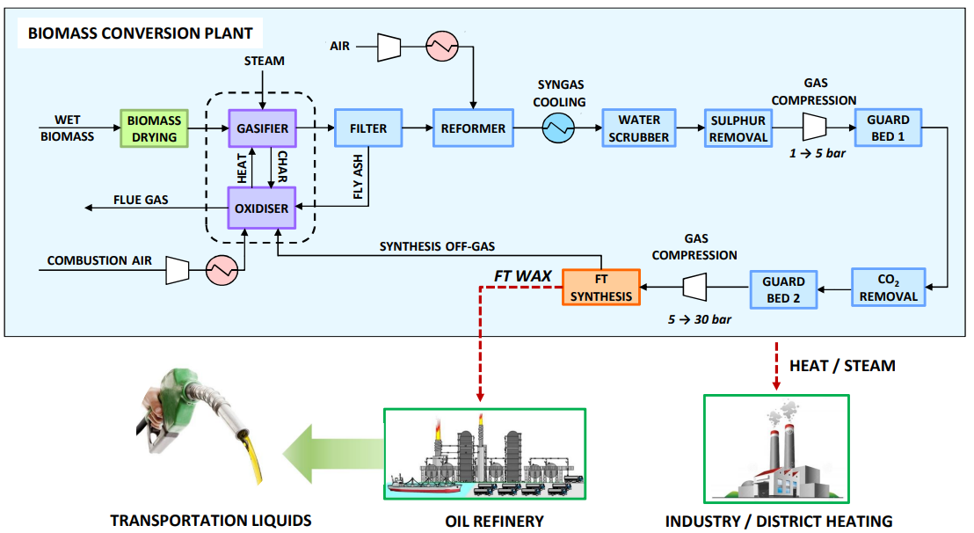
COMSYN process concept
Main Targets :
Concept: decentralized primary conversion of biomass in 30 – 150 MW units.
Target: reduction of biofuel production cost up to 35% compared to alternative routes → production cost for diesel lower than 0.80 €/l.
GHG savings: 80 %
Overall efficiency to FT biocrude + heat: 80%

Slide 5
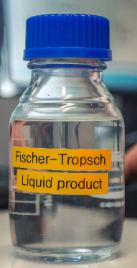
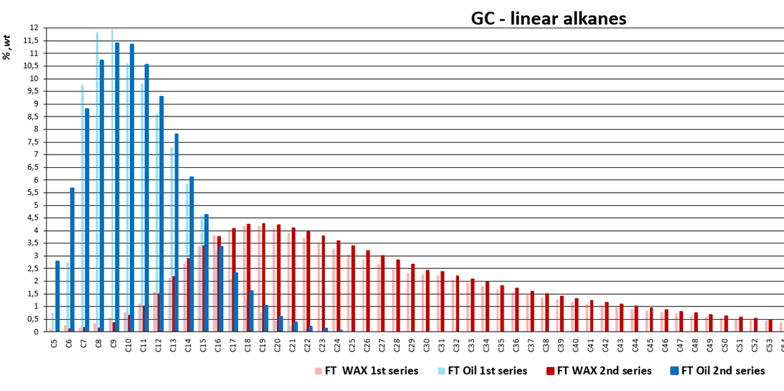
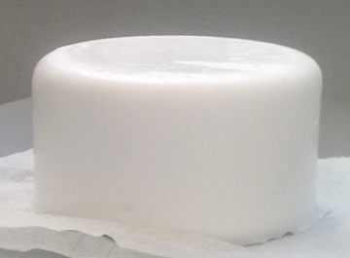
FT products characteristaion
GAS CHROMATRORAPHY
FT Liquid product - Oil
FT Wax
FT fraction 180 - 360°C
(Diesel fraction)
FT fraction 36-180°C
(Gasoline fraction)
FT fraction >360°C
(Distillation Residue)

Slide 6
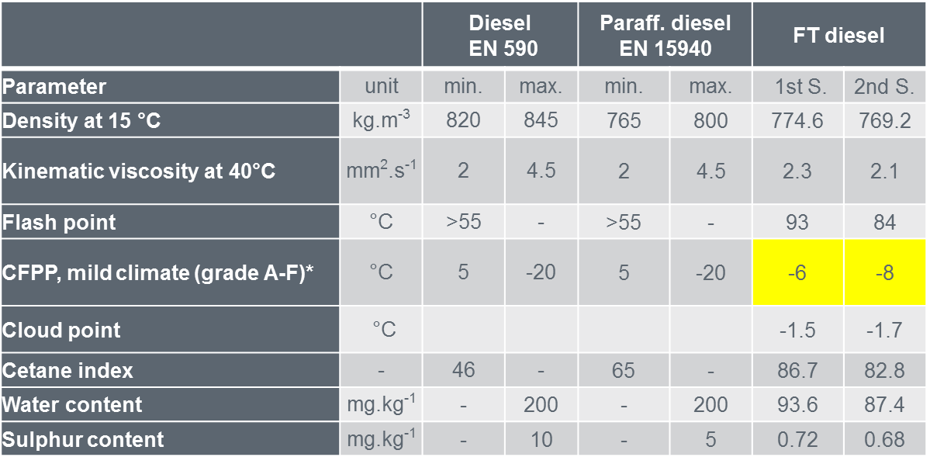
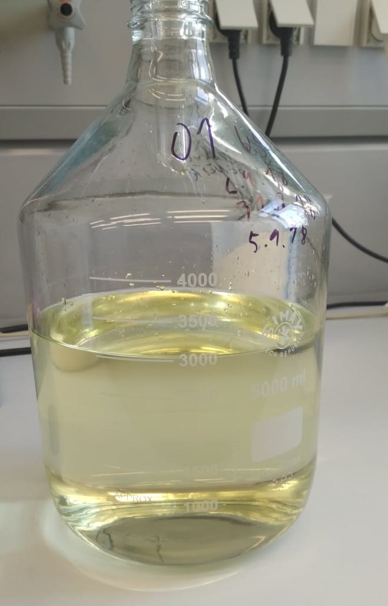
COMPARISON OF FT DIESEL FRACTION TO EN 590 AND EN 15940
* 15.04. – 30.9. grade B (CFPP max. 0 °C)
01.10. – 15.11. grade D (CFPP max. -10°C)
16.11. – 28.02. grade F (CFPP max. -20 °C)
01.03. – 14.04. grade D (CFPP max. -10°C)
Hydroisomerisation step needed
Sample of FT diesel
in collaboration with CZU Prague – dept. of Chemistry

Slide 7

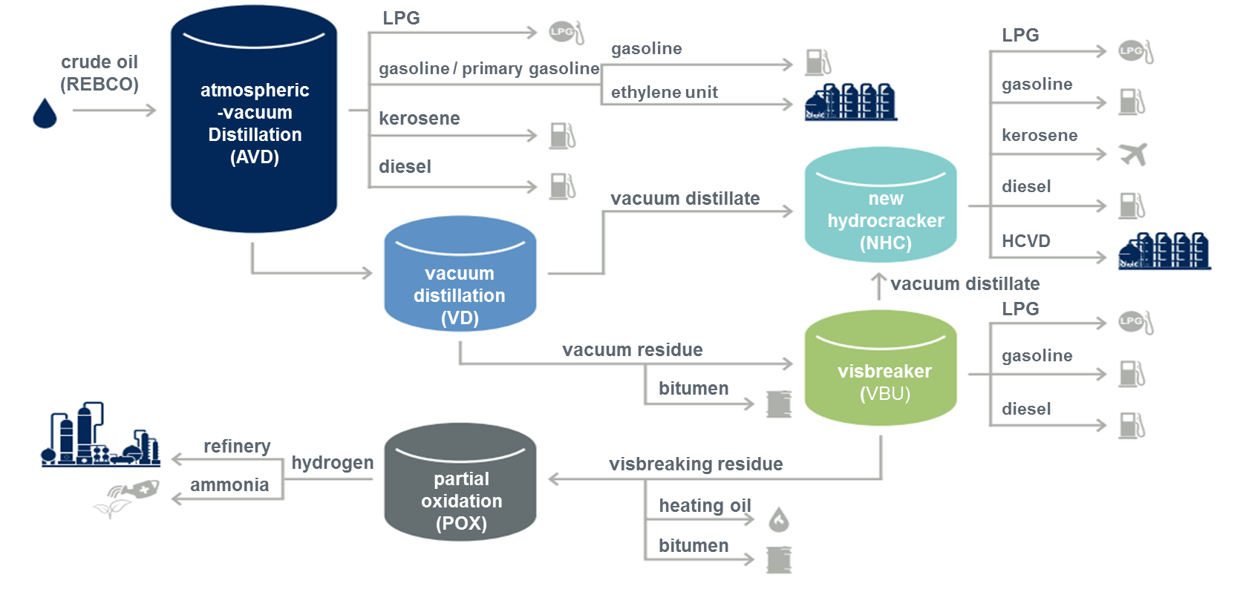
Simulation processing in existing refinery (CR)
80% reduction in the GHG emissions was reached for studied case
Obtained Production cost for biofuel is 1.10 EUR/l
FT WAX >10 wt.%
The Break-even price of FT Biofuels after refining upgrade is at 1.7 EUR/kg
BENEFIT
No benefit
CURRENTLY
84 wt. % of FT Oil+Wax is converted to motor fuels.
14 wt. % of FT Oil+Wax is converted to Steam cracker feedstock.
2.6 wt. % of FT Oil+Wax converted to fuel gas
Notes:
The real break-even price of FT Biofuels produced from FT Wax+Oil has to include the effects associated with the fact that 14 % of feed is lost in Steam cracker feed pool and 2,6 % feed is lost in Refinery Fuel Gas.
Due to the current plastics EU policy and customers requirements (Unipetrol´s customer survey), side products used for basic-plastics Production (polyethylene, polypropylene) and fuel gas have to be priced with a significantly lower value (as a fossil equivalent) than purchase cost of FT WAX+Oil.

Slide 8
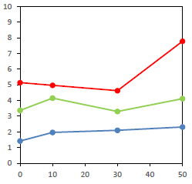
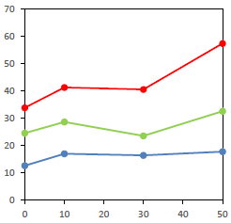
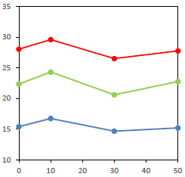
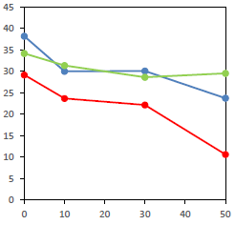
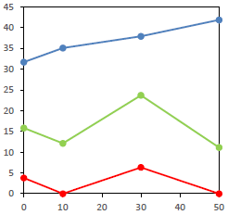
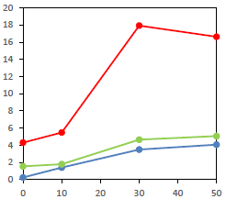
RESULTS OF HYDROCRACKING EXPERIMENTS
Hydrocracking of FT VR in co-processing with VD
Addition of FT Vacuum Residue (FT VR) 0, 10, 20, 30, 50 and 100 wt.% in the Vacuum Distillate (VD) feedstock
Hydrocracking experiments were performed at conditions: pressure of 16 MPa and reaction temp.: 390, 400 and 410 °C
Gas oil yield, wt.%
C1-C4 yield, wt.%
Gasoline yield, wt.%
Kerosene yield, wt.%
FT VR content, wt.%
FT VR content, wt.%
FT VR content, wt.%
FT VR content, wt.%
Gasoline yield C5 –150 °C
Kerosene yield 150–230 °C
Gas oil yield 230–360 °C
Dist. residue > 360 °C
Dist. Residue yield, wt.%
Sulphur content, mg.kg⁻¹
FT VR content, wt.%
FT VR content, wt.%
in collaboration with UCT Prague – dept. of Petroleum Technology
and Alternative Fuels

Slide 9
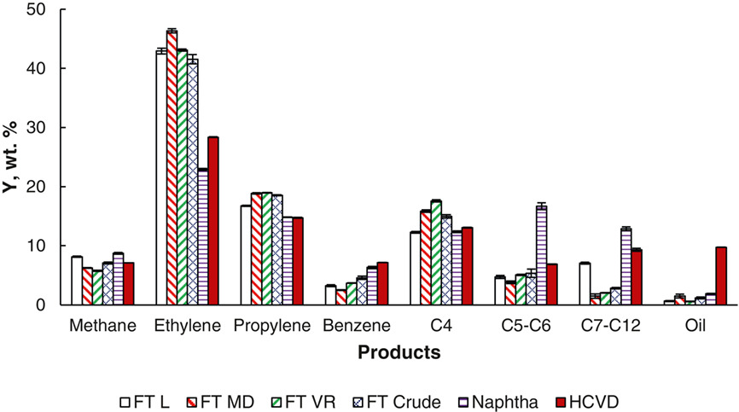
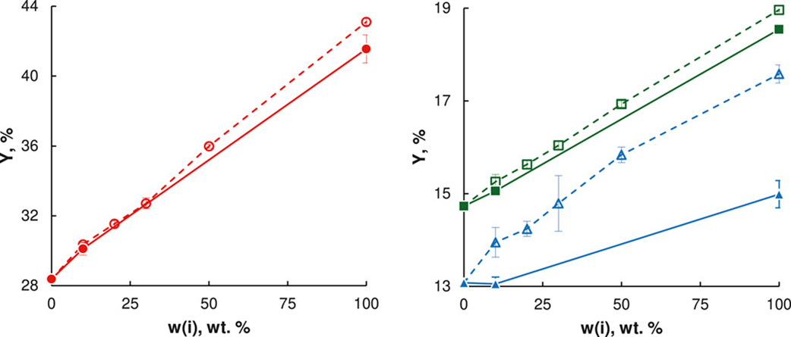
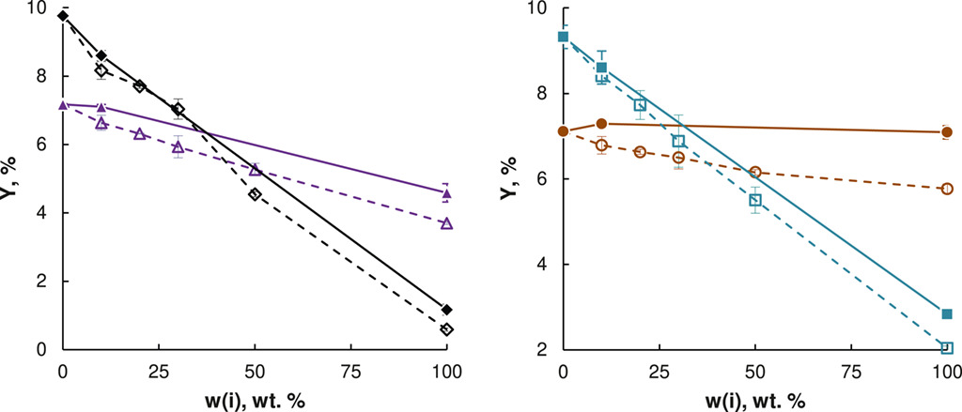
RESULTS OF STEAM CRACKING EXPERIMENTS
Main pyrolysis products of pure feedstocks
Pyrolysis products of co-processing
Addition of FT Cr (▴♦•▪) and FT VR (Δ◊○□) of 0, 10, 20, 30, 50 and 100 wt.% in the HCVD feedstock
Pyrolysis conditions: 815 °C, 65 NmL min^{–1,} 400 kPa
○• ethylene
□▪ propylene
Δ▴ C4 fraction
)
Δ▴ benzene
◊♦ oil
○• methane
□▪ C7–C12
FT L – FT lights
FT MD – middle distillate
FT VR – vacuum residue
FT Cr – crude (Wax)
HCVD – hydrocracked vacuum distillate
in collaboration with UCT Prague – dept. of Organic Technology

Slide 10




CONCLUSIONS
Reduction of crude oil consumption.
Double counting of CO₂ emissions via processing of Waste Renewable Materials.
COMSYN technology and its products are valuable source of potential feed for already existing refinery.
The addition of FT products to fossil feeds will not impair the quality of the offered fuels.
Addition of FT products showed a positive influence on the conversion of the fraction boiling above 400 °C to lighter fractions consequently causing higher production of basic plastics (already with recycled biomaterial).
Processing and co-processing of waste materials in the existing refineries will help to preserve an employment in regions currently dependent on crude oil refining.

Slide 11
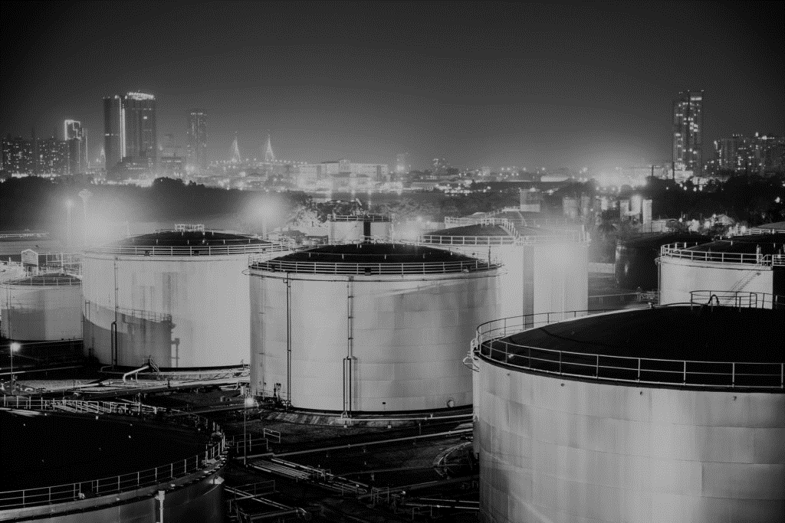









ACKNOWLEDGEMENT
VTT Technical Research Centre of Finland
INERATEC, Germany
CONSORTIUM
Industry: ORLEN UniCRE, Wood, GKN, AFRY
SMEs: Ineratec
Research organizations: VTT, DLR, UniCRE
ORLEN UniCRE,
Czech Republic
GKN Sinter Metals Filters, Germany
DLR, German Aerospace Center, Germany
Wood, Italy
COMSYN project has received funding from the European Union’s Horizon 2020 research and innovation Programme under Grant Agreement No 727476.
AFRY, Finland

Slide 12
Thank You for Your attention

