Slide 1
VIZE 2050 Konferenze Prague, 19 October 2021
FuelsEurope VISION 2050
Alessandro Bartelloni, FuelsEurope Director

Slide 2

A different world in 1995
1995
Population: 5.7 bln
GDP per capita: 10 k$
CO₂: 360 ppm
2021
7.9 bln (+39%)
16 k$ (+60%)
414 ppm (+15%)
Source: Economic Growth - Our World in Data

Slide 3

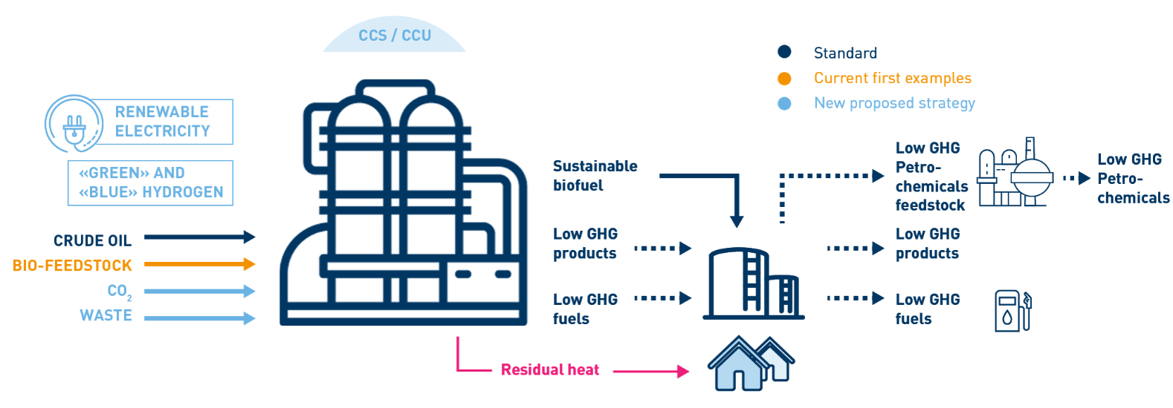
The future refinery: an ENERGY HUB…
… within an INDUSTRIAL CLUSTER
Page 3

Slide 4


What is Clean Fuels for All about?
The EU refining industry’s potential pathway to achieve climate neutrality by 2050 in all transport modes.
By 2050, at the latest, every litre of liquid fuel for transport could be net climate neutral, enabling so the decarbonisation of aviation, maritime and road transport.
Up to 650 bln€ investment over 30 years.
What are“Low-Carbon Liquid Fuels” ?
Renewable and sustainable liquid fuels from non-petroleum origin.
Produced from new feedstock such as biomass, renewable energy, waste and recycled CO₂.

Slide 5
Clean Fuels for All in numbers
Page 5

Slide 6

The EU pathway on climate regulation
2030 CLIMATE TARGET Sept. 2020
EU GREEN DEAL
Dec. 2019
CLIMATE LAW
March 2020
FIT FOR 55 PACKAGE 14 July 2021

Slide 7
Recommendations on the “Fit for 55” – focus on transport
Net Climate Neutrality 2050
Create the conditions for deployment at scale of Renewable and Low-Carbon Fuels
“Fit for 55”
FuelsEurope’s contribution to the debate
on decarbonisation of transport
Renewable and Low-Carbon liquid fuels
Before aviation and shipping, liquid fuels for road: a no-regret option
Value for transport ecosystem & affordable mobility

Slide 8
Architecture of regulatory instruments: FuelsEurope proposals
CO2 standards in vehicles
FQD 7a
Not needed → repealed
Decarbonisation of Maritime Transport
Decarbonisation of Aviation
ETS for road transport
(dedicated, separate ETS)
Possibly additional to RED
RED
(expressed as GHG target)
The cornerstone of road fuels decarbonisation
ETD
(with GHG component)
Complementary to RED
https://www.fuelseurope.eu/publication/fit-for-55-fuelseuropes-contribution-to-the-debate-on-decarbonisation-of-transport/

Slide 9
Preliminary assessment on the Fit for 55 proposals relevant to transport
  In general, the Fit for 55 proposals go in the right direction, towards creating the conditions for unlocking investments in low-carbon liquid fuels and renewable energy.
  The refinery liquid products demand (both for conventional and LCLF) is heavily impacted by ETS in transport & buildings, CO2 standards in LDVs, RED, ReFuel EU aviation and FuelEU maritime.
  While LCLFs recognised for decarbonizing aviation, maritime and possibly HDVs, their contribution to (new) LDVs decarbonisation is excluded. Impact on ability to make investment case.
  The definition of sustainable biofuels is unclear and risks imposing unnecessary restrictions.
  No sufficient assessment of impacts of rapid electrification of cars and vans on employment, supply value chain and affordability of personal mobility (especially for low-income households).

Slide 10



Henry Ford
"You can use any technology to decarbonise, as long as it’s an electric car"
On the Ford
Model T:
"You can have it in any color, as long as it's black"

Slide 11



Is a horse a “clean vehicle”?
CO2
CO2
=
=
=
=
Low
carbon
liquid
fuels
ZEV
A vehicle using renewable liquid fuels emits recycled / circular CO2 net-zero impact on climate
ZEV

Slide 12


The paradox of the tail-pipe approach
Incentives over Vehicle LifeCycle
Electricity
(grid average)
Fuel Tax Relief
BEV
Vehicle Purchase Incentives
Electricity
(100% renewable)
CO2 = 0 g/km
Annual Car Tax
Business Car Benefit Tax
Congestion Charging
100% fossil fuel
Parking Permits
ICE or Hybrid
CO2 actually measured
e.g. 95 g CO2/km
Bus Lane /Bridge/Toll privileges
100% Renewable fuel⁽¹⁾
Car CO2 Compliance Credits
(1) Climate-neutral through recycled or biogenic CO2 and low-carbon technologies in the production phase (CCS & H2)
National Level
Municipal Level
EU Level

Slide 13

Robin Hood
Robin Hood: taking from the rich to give to the poor
Subsidising electric cars, for the benefit of those who can afford them

Slide 14
Preliminary assessment on the Fit for 55 proposals relevant to transport
  In general, the Fit for 55 proposals go in the right direction, towards creating the conditions for unlocking investments in low-carbon liquid fuels and renewable energy.
  The refinery liquid products demand (both for conventional and LCLF) is heavily impacted by ETS in transport & buildings, CO2 standards in LDVs, RED, ReFuel EU aviation and FuelEU maritime.
  While LCLFs recognised for decarbonizing aviation, maritime and possibly HDVs, their contribution to (new) LDVs decarbonisation is excluded. Impact on ability to make investment case.
  The definition of sustainable biofuels is unclear and risks imposing unnecessary restrictions.
  No sufficient assessment of impacts of rapid electrification of cars and vans on employment, supply value chain and affordability of personal mobility (especially for low-income households).

Slide 15
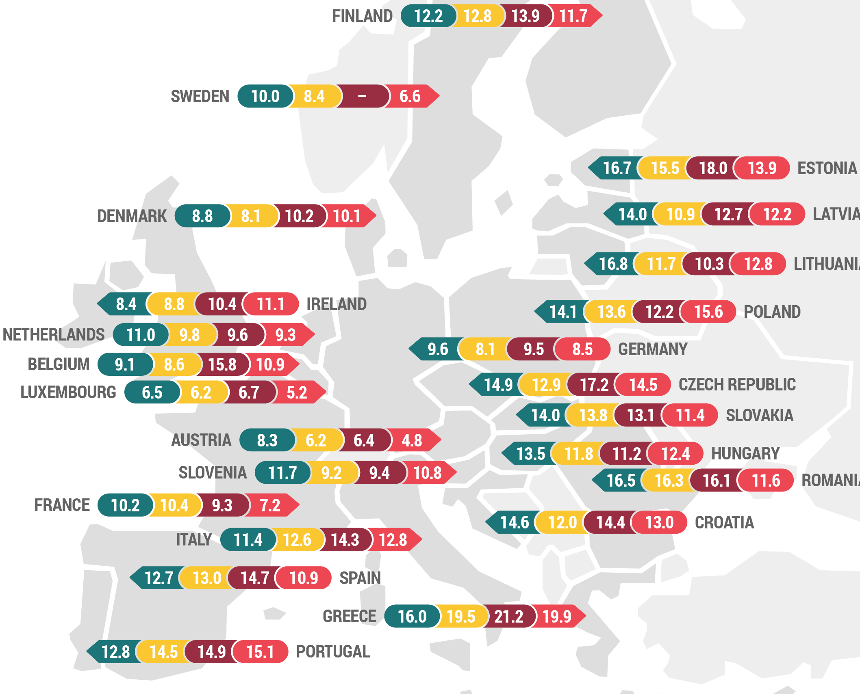
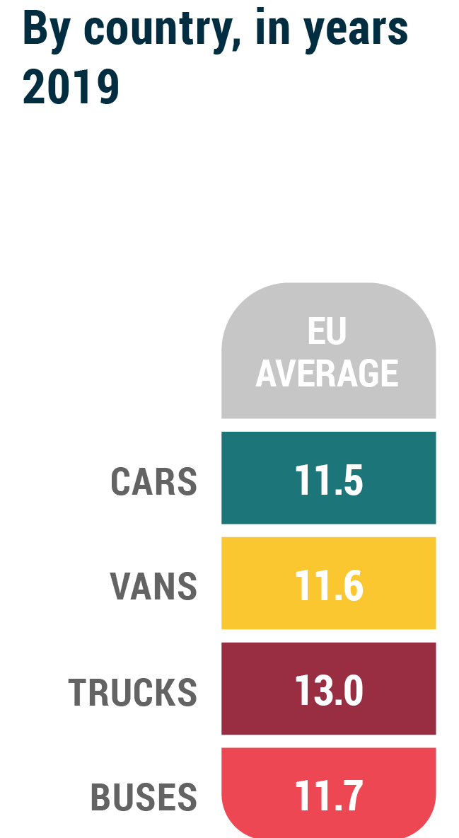

Average age of EU Vehicle fleet – 2019 (source: ACEA, Automobile Industry Pocket Guide 2021-2022)

Slide 16





A low carbon fuels strategy a good fit with Central/Eastern & Southern EU countries
New cars, especially EVs, are less affordable for citizens
Very high level of subsidies for EVs less affordable in some CEE countries
AN ELECTRIC-ONLY STRATEGY
→ Slower fleet turnover
A 2-speed Europe
Slower decarbonisation of transport
Low
carbon
liquid
fuels
Reduce the carbon intensity of ICE vehicles, new and old.
A wider social group can choose lower carbon options.
Many jobs in CEE countries dedicated to high technology ICE & Hybrid vehicles.
Transition to climate neutrality, using existing cars & trucks and fuel infrastructure.

Slide 17
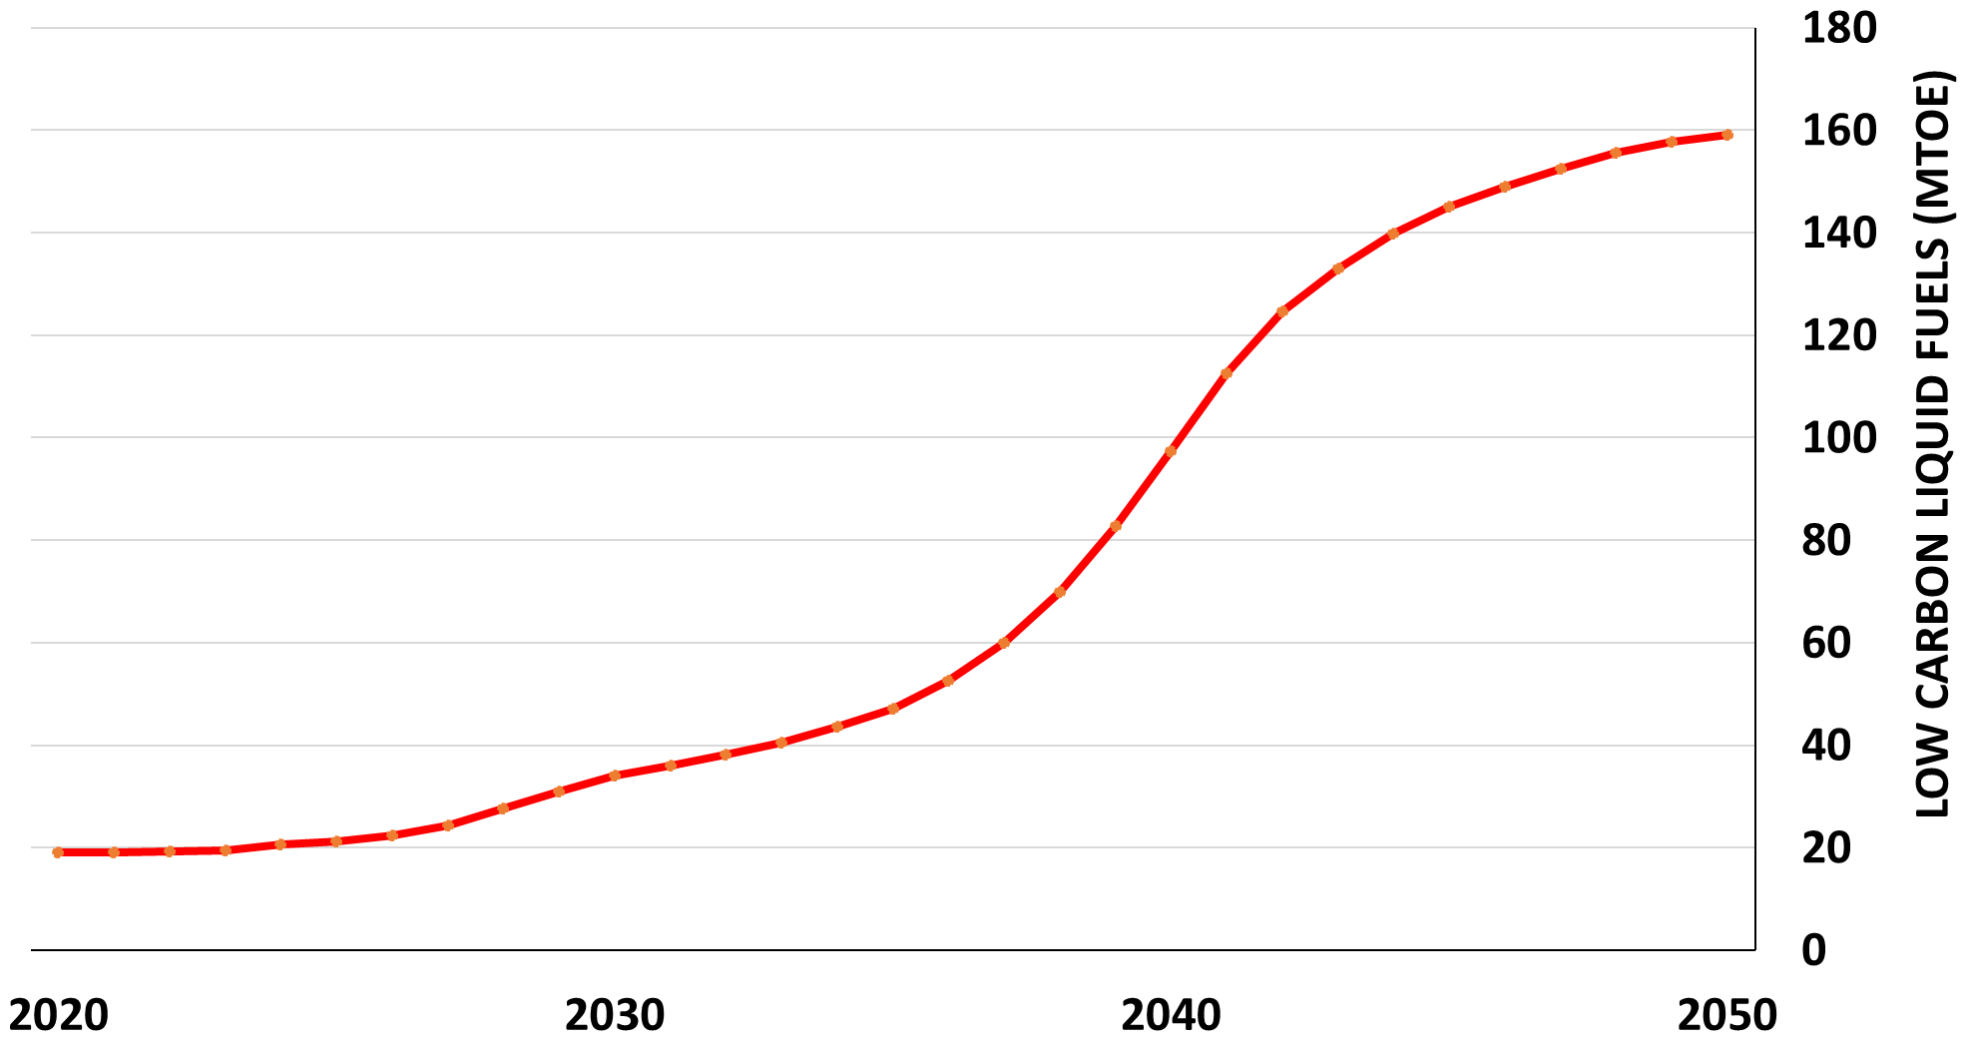
Enough sustainable biomass available for road, aviation and marine fuels biofuels
Enough biomass available to support 70 to 175 Mtoe biofuels
Enough biomass available to support 50 to 100 Mtoe biofuels
Total LCLF, of which advanced and waste-based biofuels
FuelsEurope’s elaboration, based on the Imperial College London Cons. study and Concawe’s scenario assuming LCLF in all transport modes
https://www.concawe.eu/publication/sustainable-biomass-availability-in-the-eu-to-2050/
Page 17

Slide 18
Low-Carbon Liquid Fuels progressively replacing fossil fuels in transport
Total liquid fuels (fossil + LCLF)
350
300
CONCLUSION: the potential availability of sustainable biomass is more than sufficient to allow advanced and waste-based biofuel to contribute - together with other solutions - to the decarbonisation of EU transport!
TOTAL LIQUID FUELS IN TRANSPORT (MTOE)
84%
40%
10%
5%
Total LCLF
FuelsEurope’s elaboration, based on Concawe’s scenario assuming LCLF in all transport modes
Page 18

Slide 19
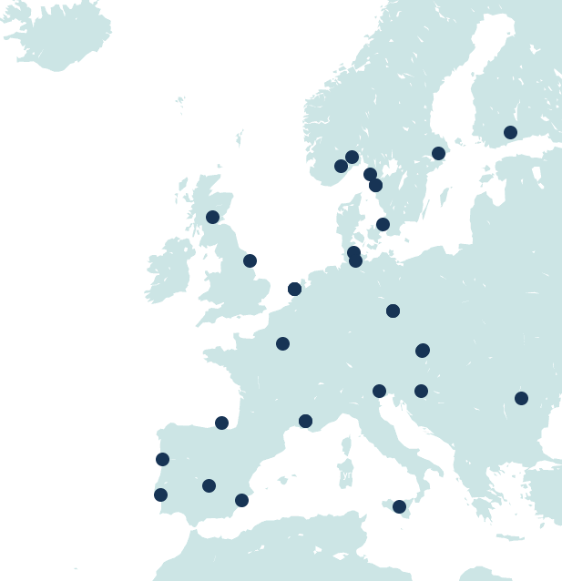
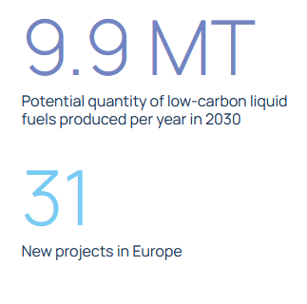
Transition to low-carbon liquid fuels initiatives
FuelsEurope’s members pursue a wide range of low-carbon initiatives across at least 12 member states in different phases of the project cycle, including CCUS, E-Fuels, Green H2, Advanced biofuels, bio-refinery conversions, waste to fuel, etc.
  Well over 20 projects for low-carbon liquids have already been started or are planned until 2030 (in the public domain)
  Projects facilitate industrial clustering though links with Chemicals, Recycling, Steel and Cement Industries, …
  Scaling up and increasing the overall number of projects will be possible with the right enabling framework in place
Provisional examples*:
9 Advanced biofuel projects, with capacities between 100.000 and 750.000 tonnes of output.
7 CCUS projects, up to 6 mt. of capacity for CO2 sequestration.
12 Green Hydrogen Projects, some of which lower the GHG intensity of manufacturing processes, others combine the green H2 with captured carbon to produce synthetic fuels with a capacity of up to 3.4 million tonnes of output per year.
3 Waste-to-fuel projects, with a capacity of up to 100.000 tonnes per year in output (derived from urban waste).
  See more:
  https://www.cleanfuelsforall.eu/towards-climate-neutrality/
  https://www.concawe.eu/low-carbon-pathways/
*While the final list of projects may differ from the map or the list shown here, these projects are being considered by FuelsEurope’s members to be put forth for support under the EU Recovery Fund.

Slide 20
www.cleanfuelsforall.eu
Thank you

